Slide 1
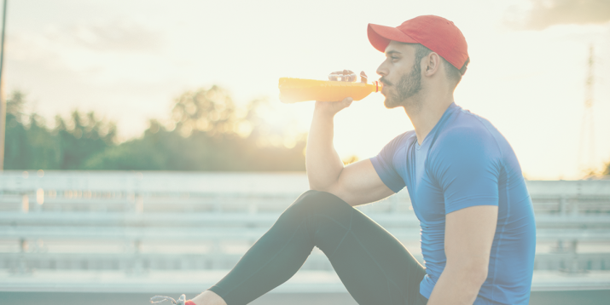
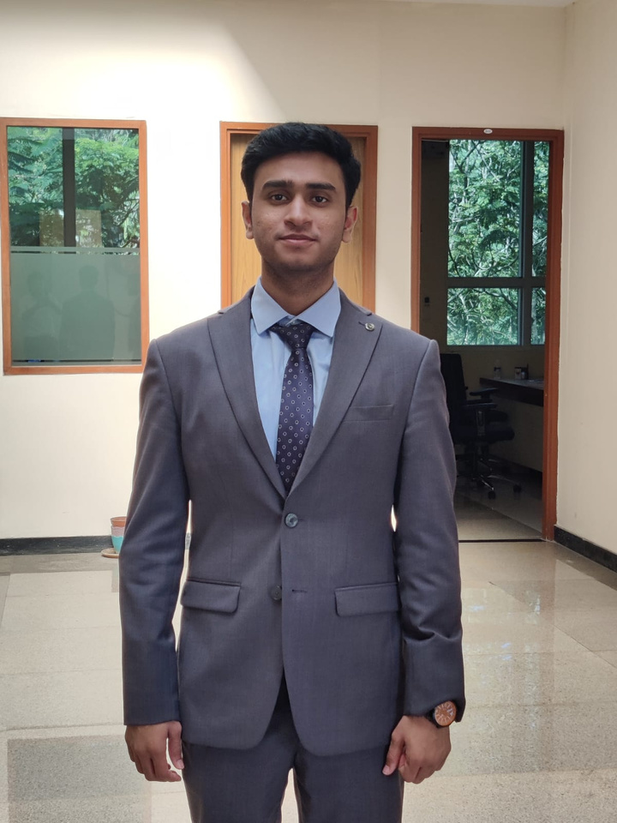
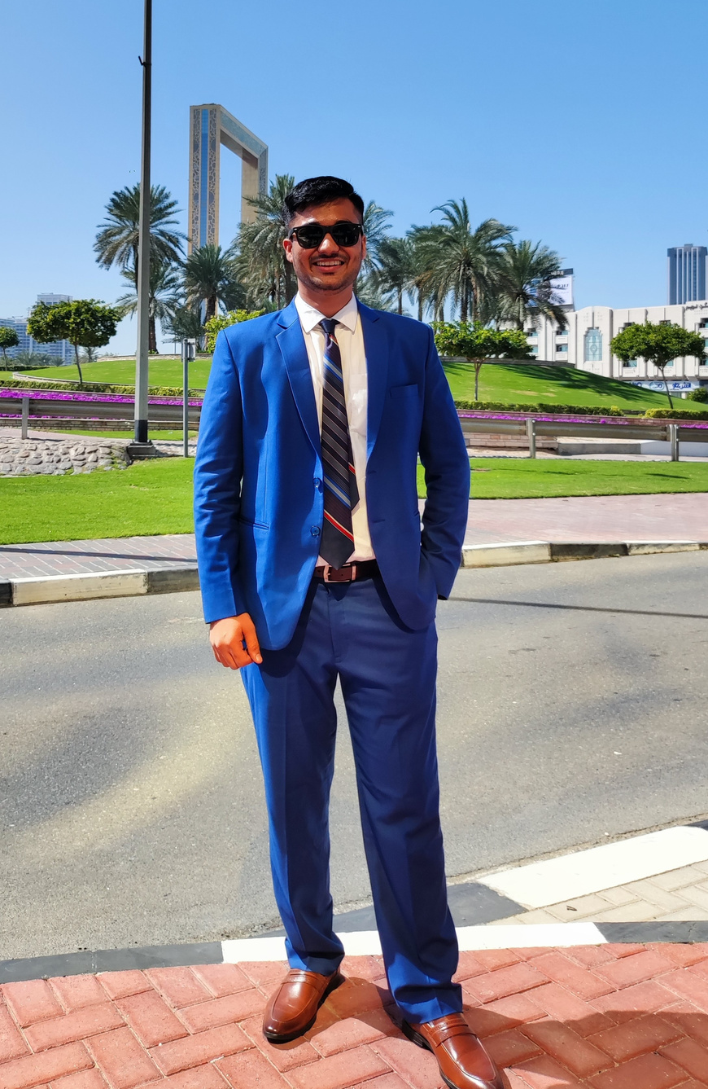


The Unstoppable Minds
Rutu Barve
Shashank
Navandhar
Sundhara
Pandiyan
“All Stars”
T.A. Pai Management Institute

Slide 2
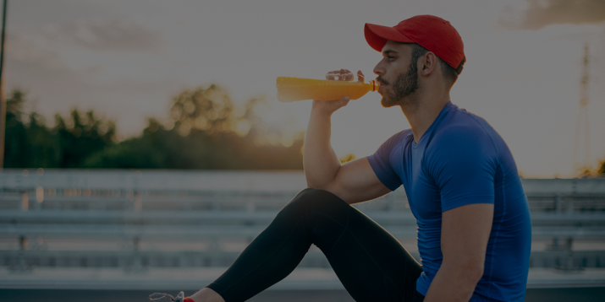


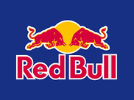

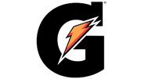

Market Analysis
Competitor Analysis
Target Group
Consumers today are more conscious of their well-being and indulge in various practices, such as gym, exercise, and yoga.
Fitness
Freaks
Athletes
Adrenaline
Junkies
RAMP
UP
Caffeine
The increasing inclination towards health and fitness regimes is predicted to boost the demand for pre-workout supplements. convenience and ease of use.
Price
Market Size
Global Health & Fitness Supplement market is at 20 Billion in 2023. India’s share in this Global Market is 5.6% resulting in a servicable market of 1.16 Billion based on research by Future Market Insight.
1.44
1.34
1.247
Ramp Up also differentiates itself from its competitors based on its Taurine content.
A 2023 study in the Journal of Bioenergetics and Biomembranes by authors M.K.Nam & J.N. Kim confirms taurine's ability to stabilize mitochondrial membranes, leading to enhanced energy production by up to 47%.
1.16
The market is predicted to register a noteworthy CAGR of 7.5%
2022
2023
2024
2025
Indian Health & Fitness Supplement Market Growth Over the years

Slide 3
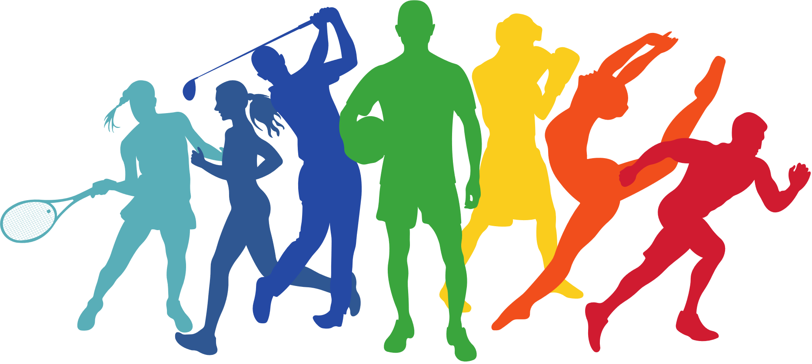
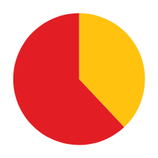
Customer Profile
Fitness Freaks
Athletes
Adrenaline
Junkies
Age: 18-40 year olds
Gender: Primarily male, but female participation is growing rapidly.
Motivation: Enhance performance, boost energy, increase muscle growth, and improve endurance.
Workout Regimen: Regular gym-goers, participate in intense workouts like CrossFit, HIIT, or weightlifting.
Age: 25-35 year olds
Gender: More balanced demographic compared to fitness enthusiasts.
Motivation: Create a surge of energy, conquer daring experiences.
Workout Regimen: Participates in marathons, trek and other adventure sports.
Age: 18-24 year olds
Gender: All Genders
Motivation: Improve recovery, Sustain Energy and gain a competitive edge.
Workout Regimen: Sport-specific training programs with high intensity and focus on skill development.
Millennial respondents Interested in new experiences
Don't Just Train.
Ignite your Beast.
Interested
Not Interested
38%
*2000 Respondents
62%
How to Target : Highlight functional benefits. Speak their language. Elevate the visuals.
2019 study in Nutrients reported caffeine use among cyclists increased from 37% in 2004 to 84% in 2014.
2023 survey by Deloitte reveales 62% of millennials are interested in trying new and adventurous experiences.

Slide 4
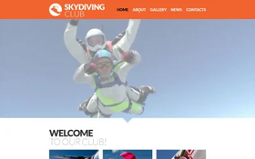
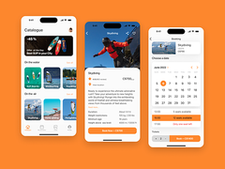



Marketing
Content Marketing
Social Media Engagement
Influencer Partnerships
Establish a strong social media presence on platforms like Instagram,
Facebook & YouTube.
Promote fitness supplements through engaging content and interactive strategies, including contests and customer stories.
Create a website with succinct, SEO-optimized content on :
Fitness
Nutrition
Health,
Partner with credible fitness influencers or experts whose values align with your brand.
leveraging their substantial following to endorse your products and reach your target market effectively.
Offertips & cultivate a blog with regular articles for increased visibility & engagement.
Reviews
Affiliate programs
Partnerships
Watching people enjoy dark chocolate tirggers "Social Proof" making others crave it too.
Businesses with reviews are perceived as 27% more trustworthy than those without. (Source: Trustpilot)
Establish an affiliate program where fitness centers can earn a commission for promoting and selling your products.
This incentivizes them to recommend your supplements and extends your reach through their networks.
Collaborate with complementary fitness brands to host joint events or workshops, or cross-promote each other's products.
This can expand your reach and
introduce your brand to new audiences.

Slide 5


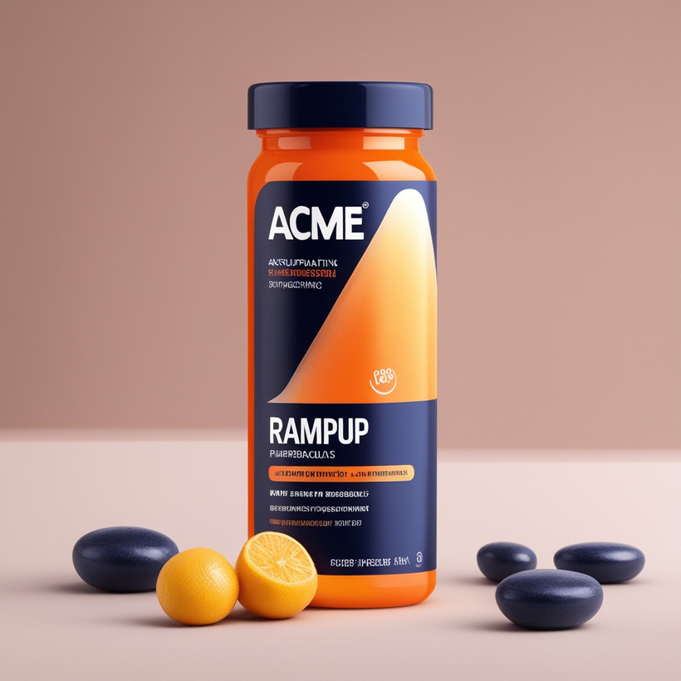
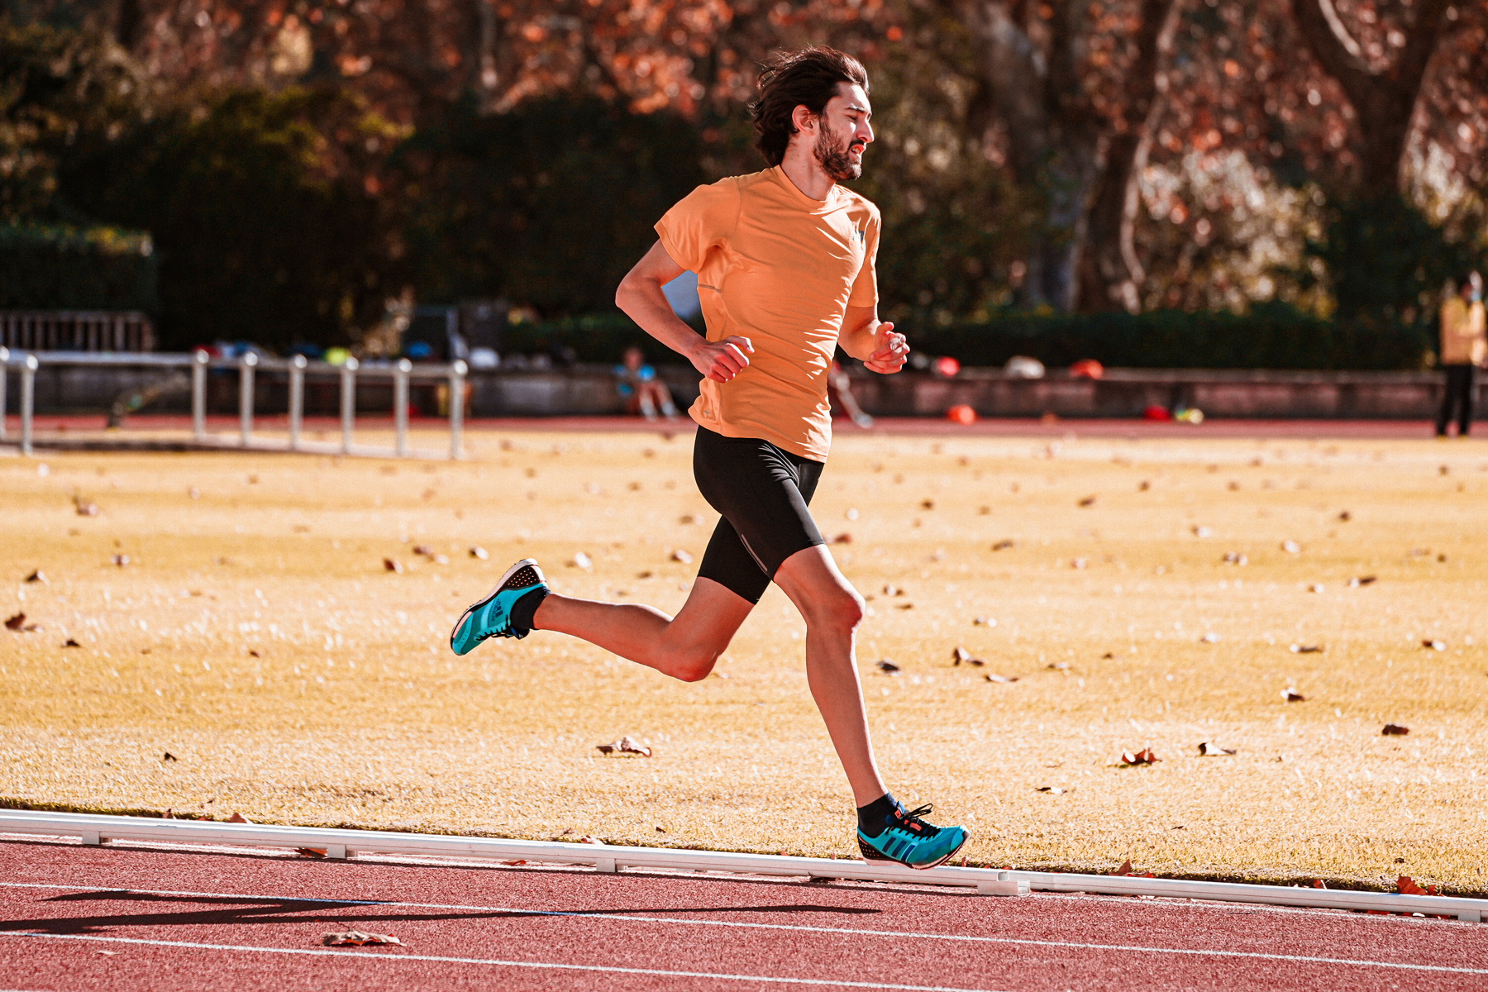


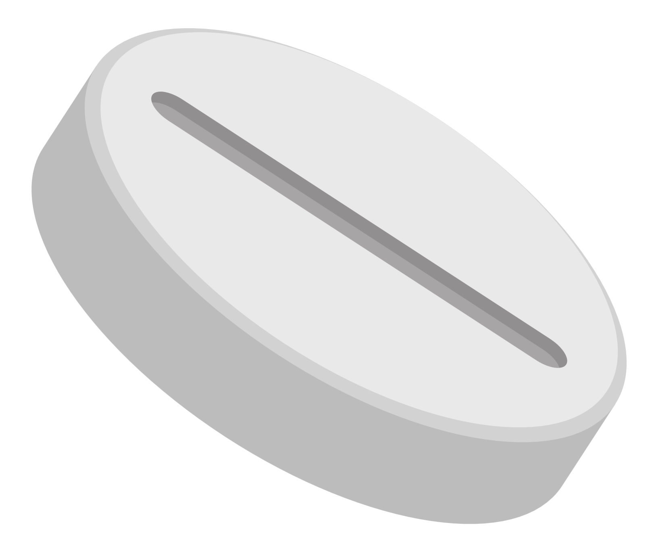

Ramp Up
Ramp Up
RAMP
UP
RAMP
UP

Slide 6




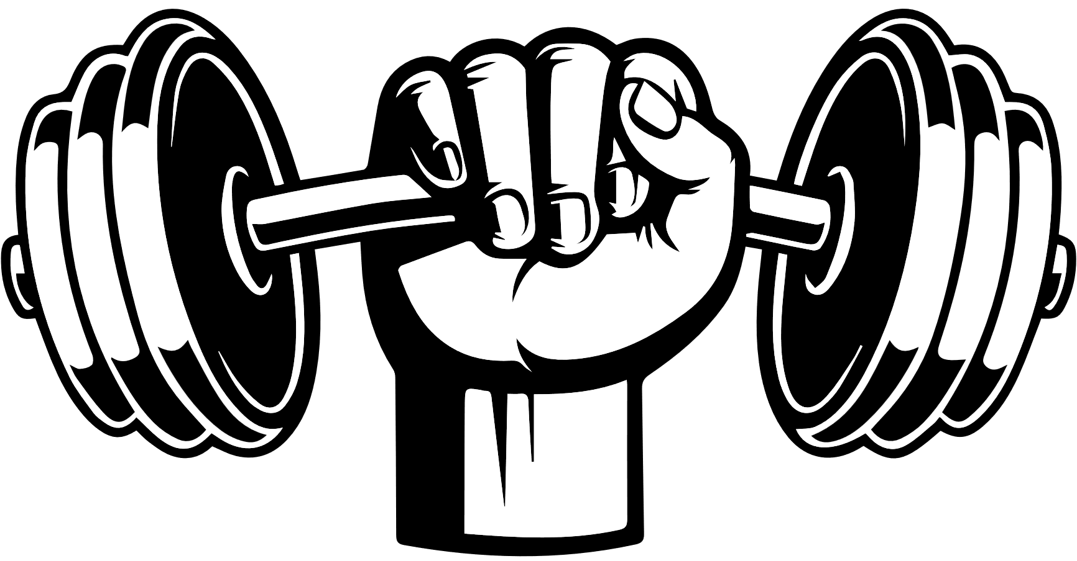
Channels
Offline
Online
Company Website: Optimize the official company
website for a user-friendly experience.
Provide detailed product information, customer testimonials, and reviews.
Implement an easy and secure online purchasing process.
E-commerce Platforms (Amazon, Flipkart, etc.): Run targeted online advertising campaigns. Offer exclusive promotions or bundles for online customers.
Social media: Run targeted online advertising campaigns,
partner with influencers.
Supermarkets/Hypermarkets: Ensure prominent shelf placement and attractive product displays.
Offer in-store promotions and discounts to attract customers.
Departmental Stores: Collaborate with departmental stores for product placement.
Implement eye-catching in-store advertising.
Convenience Stores: Focus on packaging that stands out in smaller store spaces.
Implement point-of-sale displays to grab customer
Other Sales Channels: Targeting health and wellness centers for potential distribution.
Collaborate with pharmacies and supplement stores.
Gym Partnerships
Official energy drink: Become the official energy drink of a gym chain or individual gyms. This involves branding placement within the gym
Rentech Digital's SmartScrapers Reported 9.9 CAGR of growth in registered gyms in India betweeen 2022-2027
9.95%
Event sponsorship: Sponsor fitness events hosted by gyms, such as marathons, boot camps, or charity runs. This provides visibility at the event and association with a healthy lifestyle.
55 K
80 K
2022
2027

Slide 7
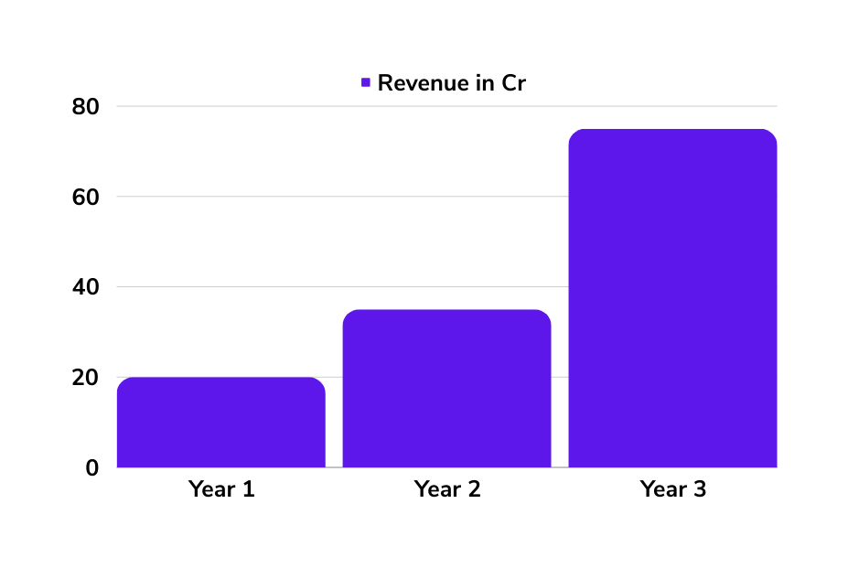


Finance
Price
Projections
Value-based pricing: It's a high-value product as it comes with an optimal amount of caffeine and taurine
Rs40/Serving
Retail: Rs 799 for 20 capsule boxes
Wholesale: Rs 499
Bundled pricing: For online channels
Rs 1299 for 2 X 20 box
India is a bang for buck market so low price and heavy marketing for high volume is the way ahead.
WHOLESALE
ONLINE

Slide 8
